Slide 1
Online voting system
Online voting system
Pavan Varshney, Shyam Gupta, Priyanshu Hajela, Prakhar Mishra, Pratham Srivastav
GLA University, Mathura (281406)
B.tech CSE
Date: 01-12-23

Slide 2
INTRODUCTION
Welcome and Project Title: "Revolutionizing Democracy: Online Voting System“.
Its main motive is to vote the best participants of any competition with complete securely.
It can be used in schools, colleges and any other professional purposes.
Its working is different and secure from other voting sites and apps.

Slide 3
Objectives
Enhance accessibility and convenience for voter.
Ensure the security and integrity of the voting process.
Increase voter turnout through user-friendly interfaces.
To get the best participants on the basis of audience voting in any competition.

Slide 4
Problem Statement
This voting system provide secure voting by which a user can vote only at once.
User can use their mobile no. and password for voting any participants.
It is important for voters such as increased voter turnout and quicker results.

Slide 5
Literature Review
We use XAMPP software to handle Apache server and MySQL database.
XAMPP software gives suitable environment for provides output in local computer.
MySQL is a technology which is used to maintain overall data of voters and candidates in this system.
We created a database with name “online-voting-system” in MySQL.

Slide 6
Methodology
Html, CSS, PHP and MySQL languages are used to complete this “online voting system” project.
We created a database and a table with the name of user inside this database.
HTML is used to create a website and helps in developing fundamentals about web programming.
CSS is a style sheet language used for describing the presentation of a document written in HTML language.
PHP code are executed on the server and the result is returned to the browser as plain HTML.

Slide 7
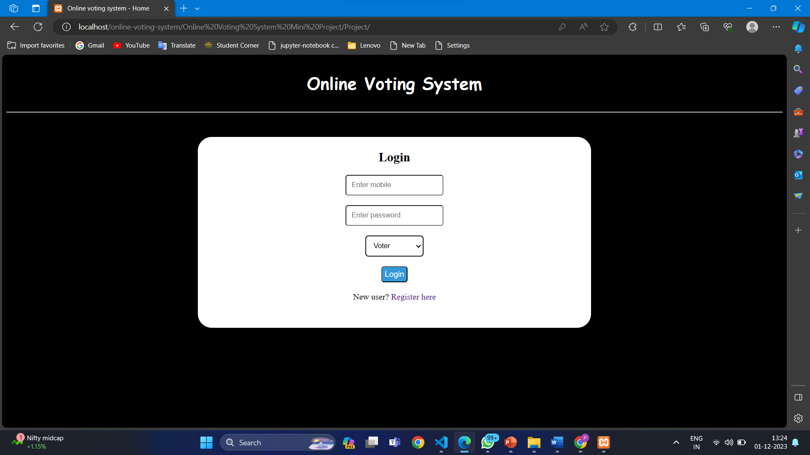
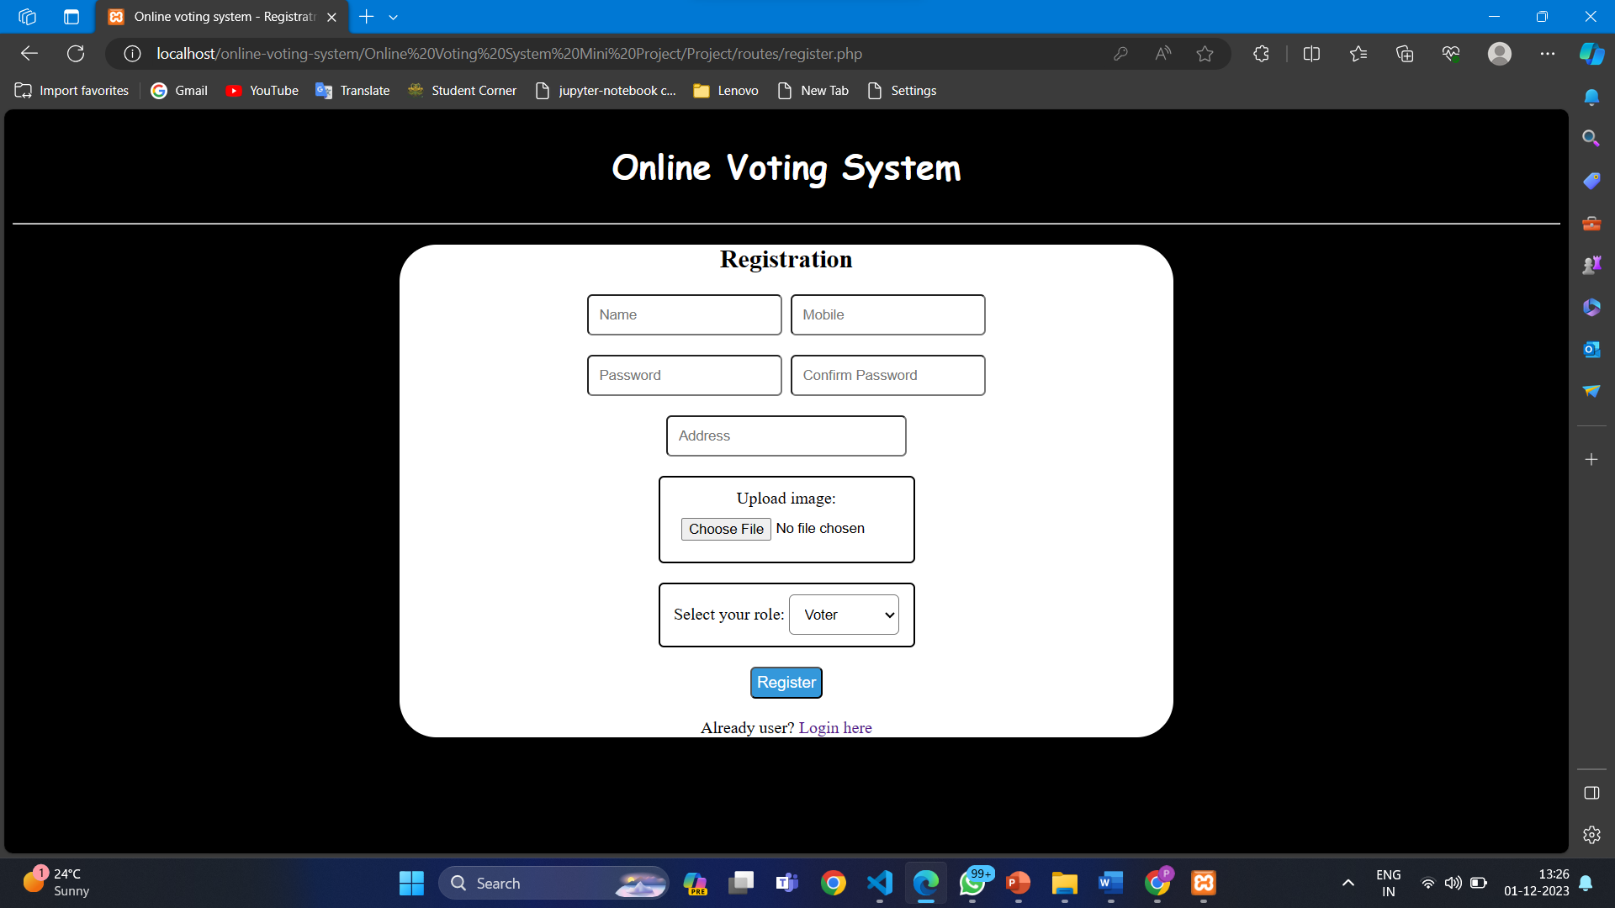
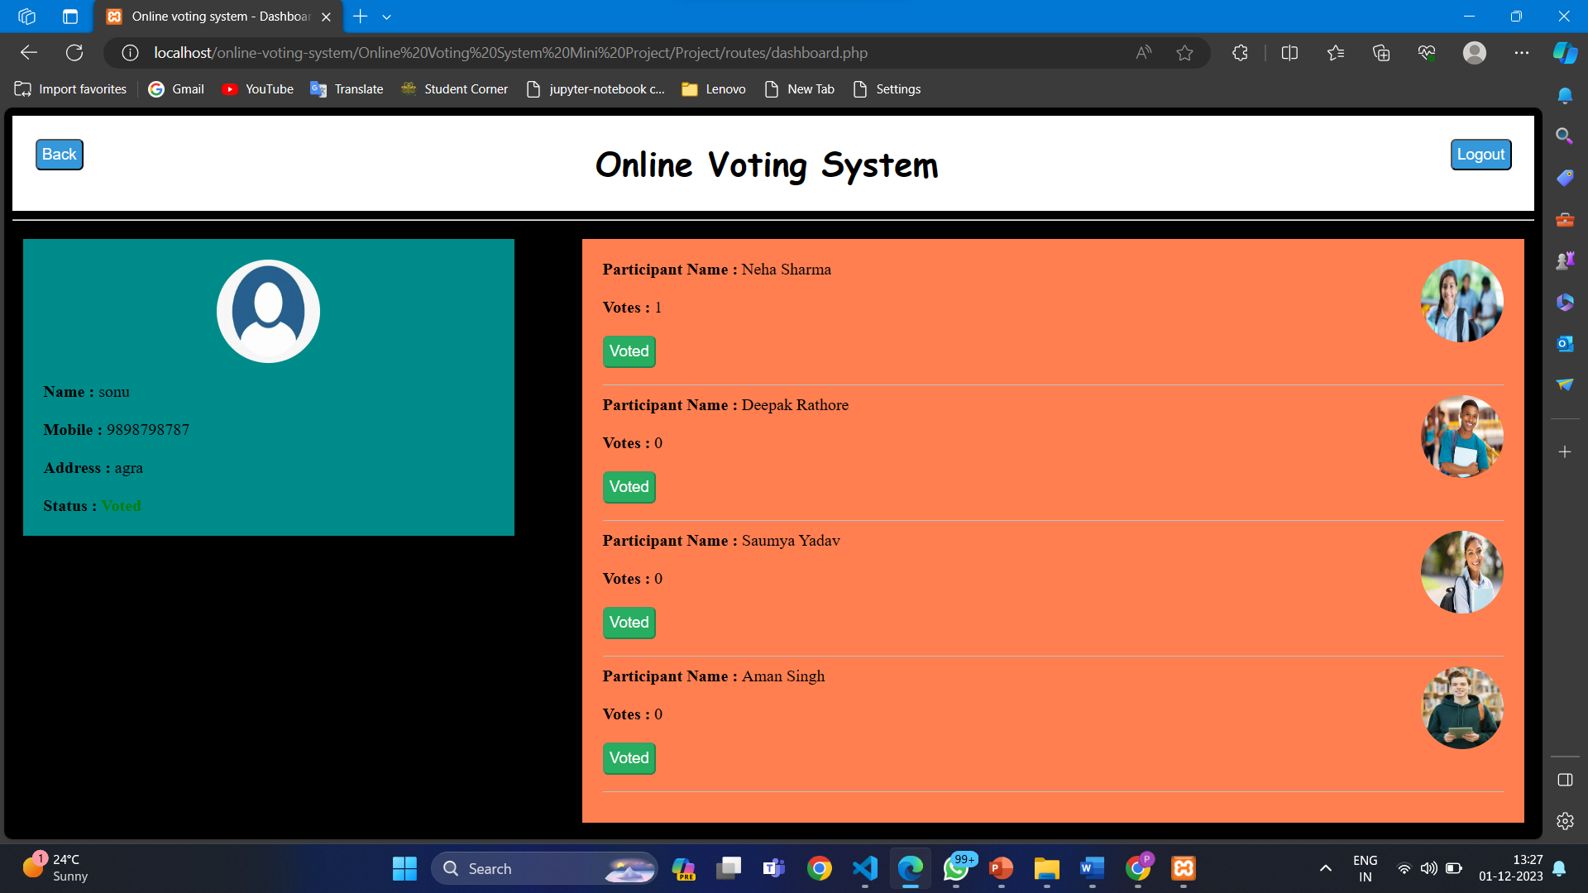
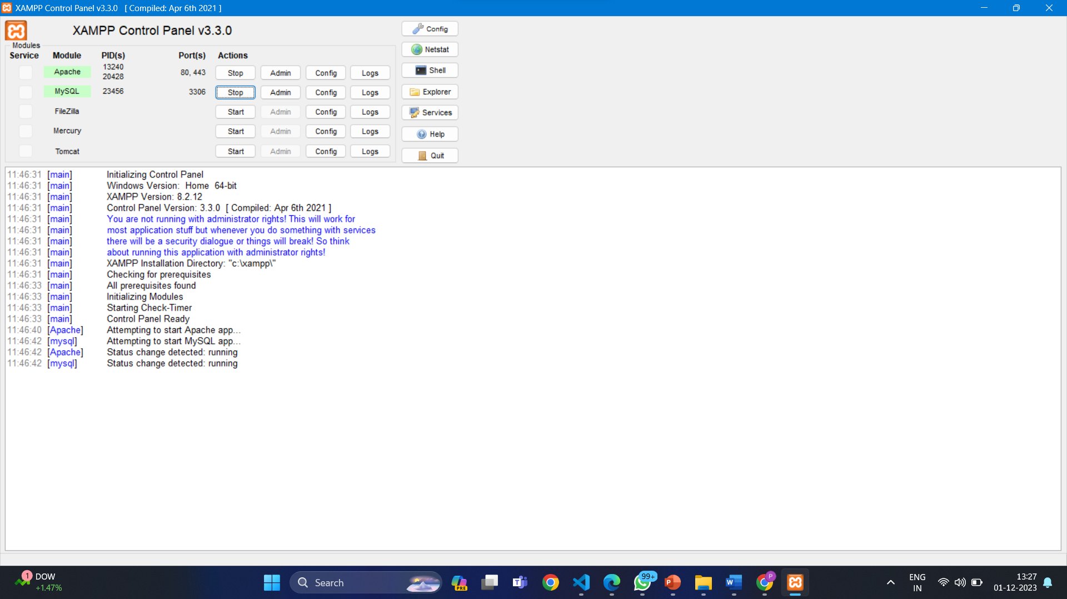
Implementation
Some snapshots of projects.

Slide 8
Future Work
We want to do some improvement in this project in future such as OTP System, more secure.
Other improvement such as audience don’t need to setup XAMPP software to vote others.
In future, work onto add a new features through which user can vote through a link.

Slide 9
Conclusion
So the final conclusion we make here is that our new online voting system is much better and easy to use than traditional voting system. Almost all problems that we have discussed in existing voting system are resolved by the help of this application. So the launch of this application would create many opportunities for those who are frequently involved in conducting elections for different purposes.

Slide 10
Acknowledgments
It is our proud privilege to express our profound gratitude to the entire management of GLA University and the teachers of the institute for providing us with the opportunity to avail ourselves of the excellent facilities and infrastructure. The knowledge and values inculcated have proved to be of immense help at the very start of my career. Special thanks to the Hon’ble Founder, GLA University, Mathura for having provided us with an excellent infrastructure.
I am grateful to Ms. Ruchi Talwar for their astute guidance, constant encouragement and sincere support for this project work.
Sincere thanks to my mentor and friends for their support and assistance throughout the project.

